Slide 1

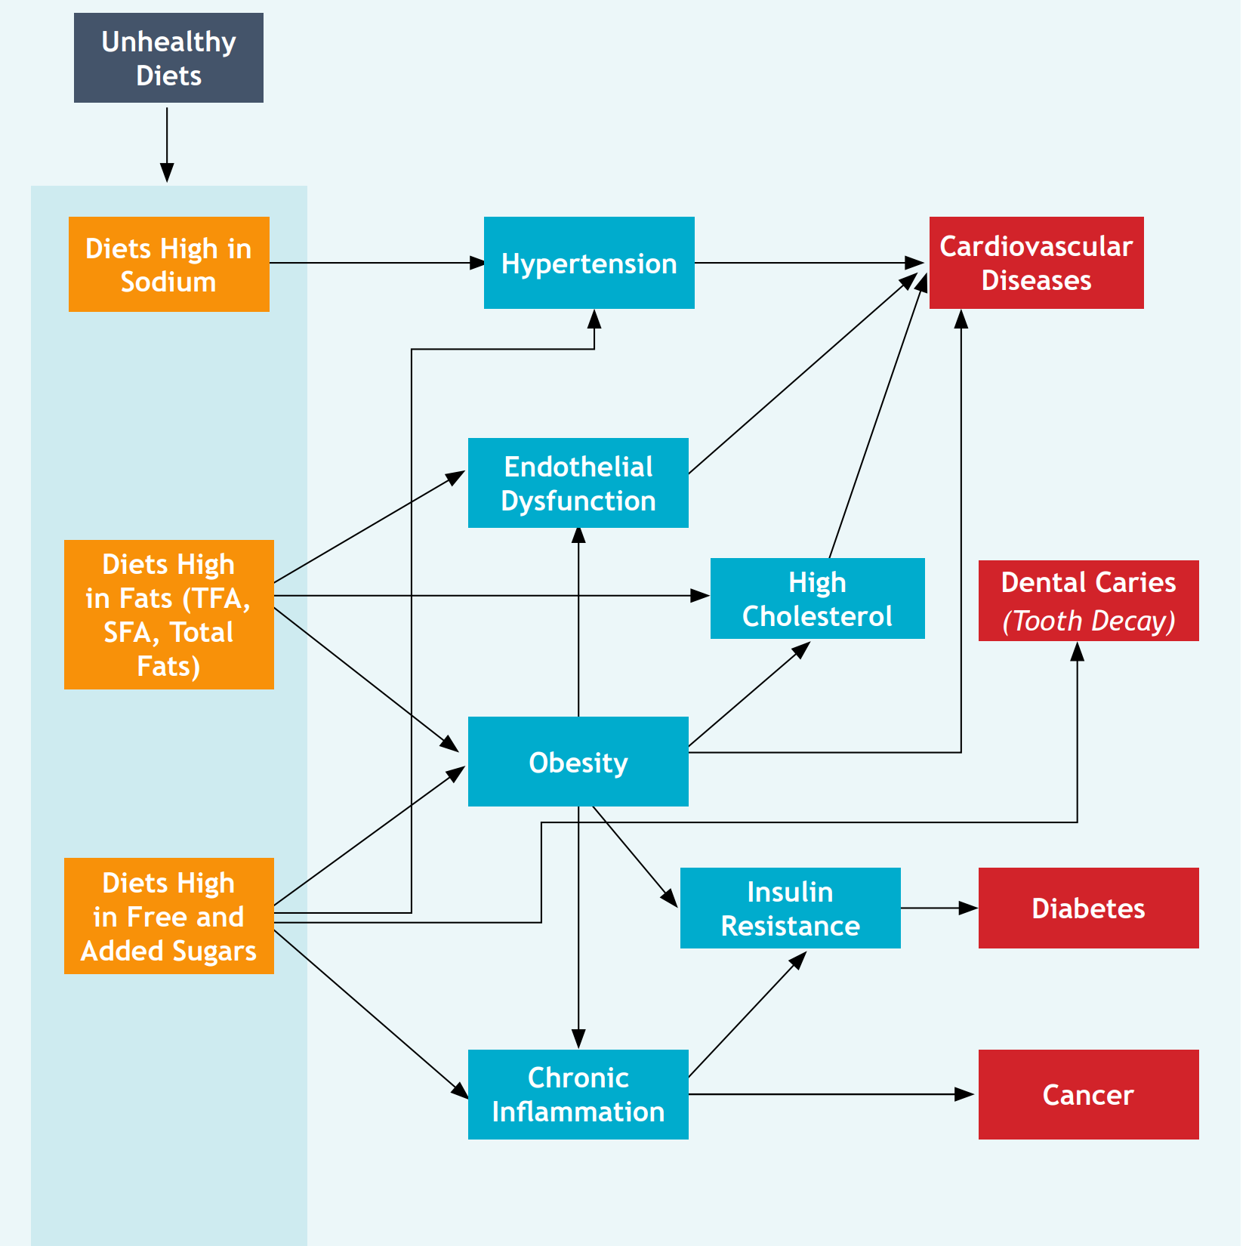
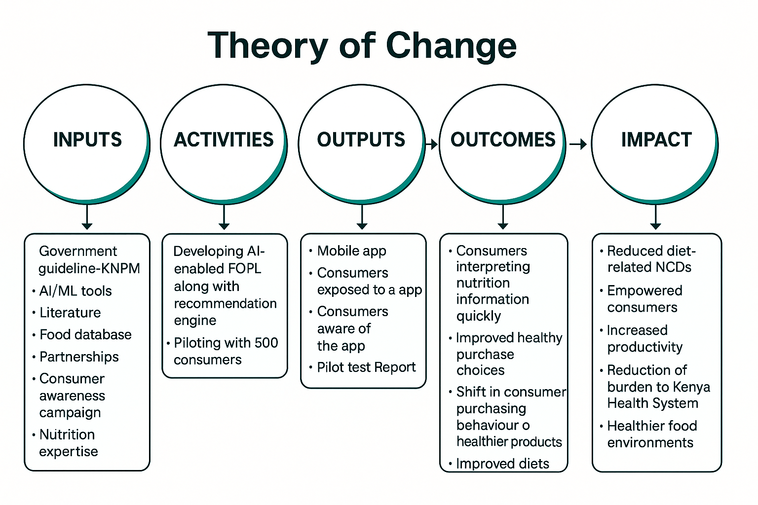
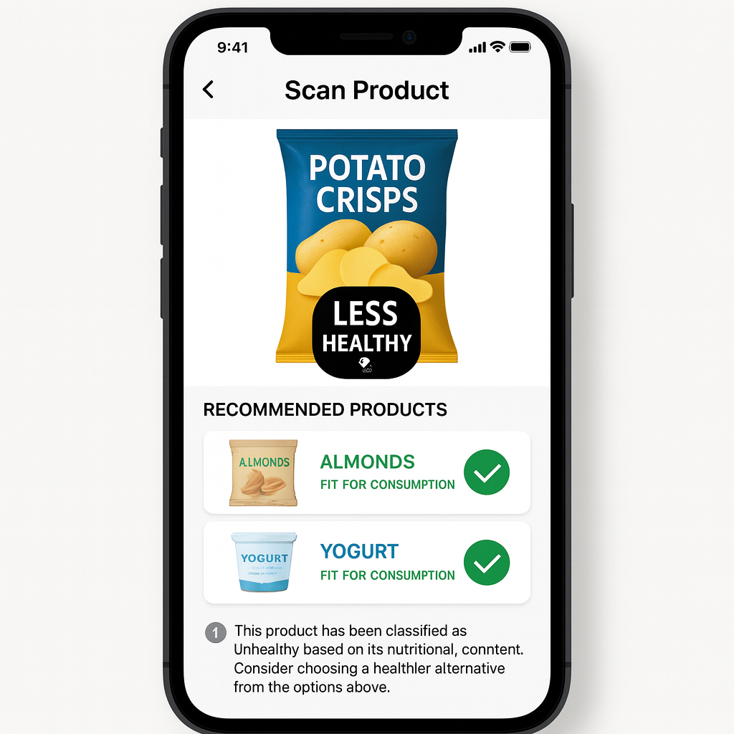
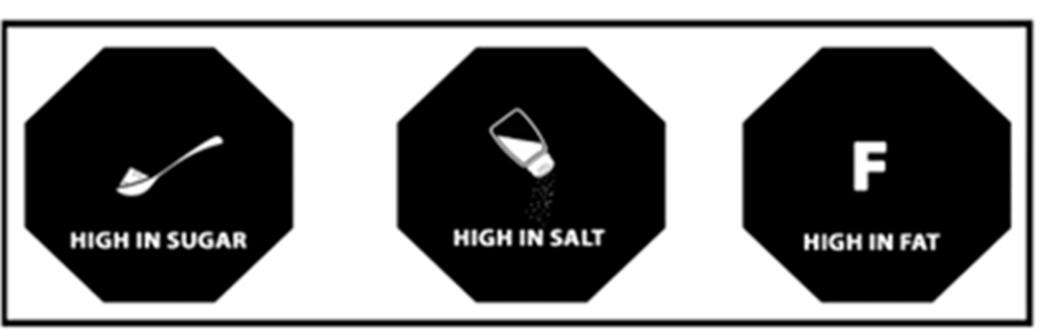
Making Healthy Food the Easier Choice in Kenya through Artificial Intelligence
Tatenda Duncan Kavu, Reinpeter Momanyi, Steve Cygu, Agnes Kiragga, Gershim Asiki, Shukri Mohamed, Zachary Ndegwa Muriuki, Silas Ooko, Evans Omondi
NCDs account for half of the total hospital admissions and over 55% of hospital deaths and 40% of all deaths in Kenya
Unhealthy diet is the leading risk factor
Limited consumer knowledge on unhealthy food
Theory of Change
Objectives
Additional Objectives:
Influence change of purchasing patterns
Pilot a prototype labeling scheme on at least 1000 diverse food items.
Test the scalability and usability of a mobile application that integrates FOPL and AI-based recommendations, through a field pilot involving at least 500 consumers across three counties in Kenya.
It is a small-scale pilot designed to test:
Consumer uptake of the idea
Change in purchase patterns
Beyond the Big Idea Fund:
Scale it up and run a trial across the entire country
Explore pilot results to influence manufacturers to produce healthier products
Sustainability:
Self-funding through subscriptions

